Slide 1
Loan Application
Spring Boot JPA

Slide 2
Steps for Configuration & Coding
Creating Maven project.
Adding required dependencies & configuring jre to 1.8.
Adding necessary properties required for DB connection & logging.
Creating basic project structure with all the packages.
Coding for the requirements.
Calling RESTFUL service from Postman (consumer).
Creating Test cases to check the correctness of the code.
Configuring the logger to add the logs into the file.
Testing the correctness of the code using JUnit Test cases.
Analyzing the code using code coverage.

Slide 3
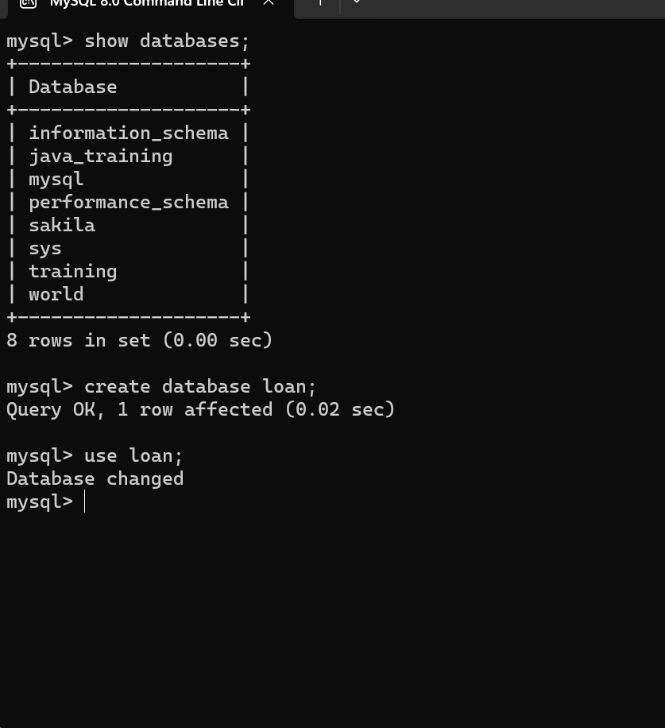
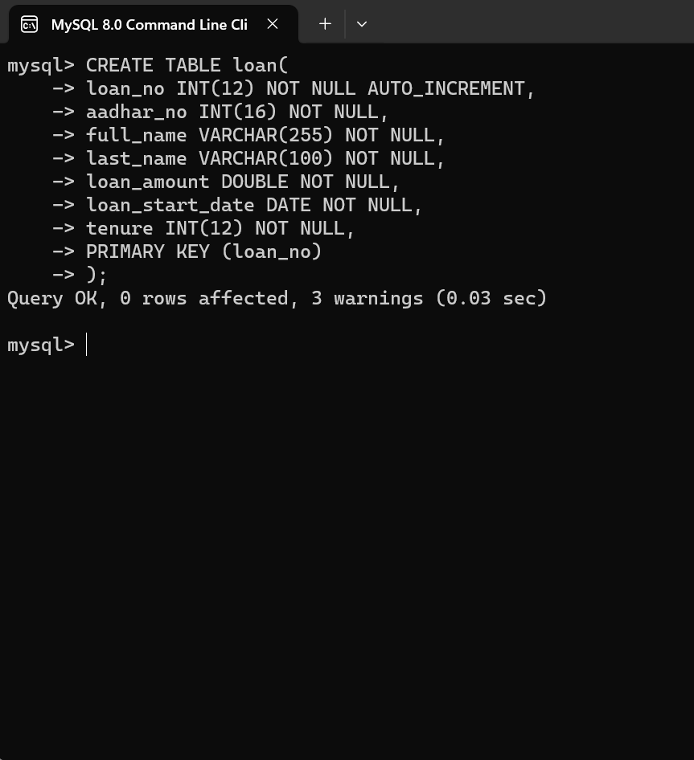
Task - 1 : Creating Database & Table

Slide 4
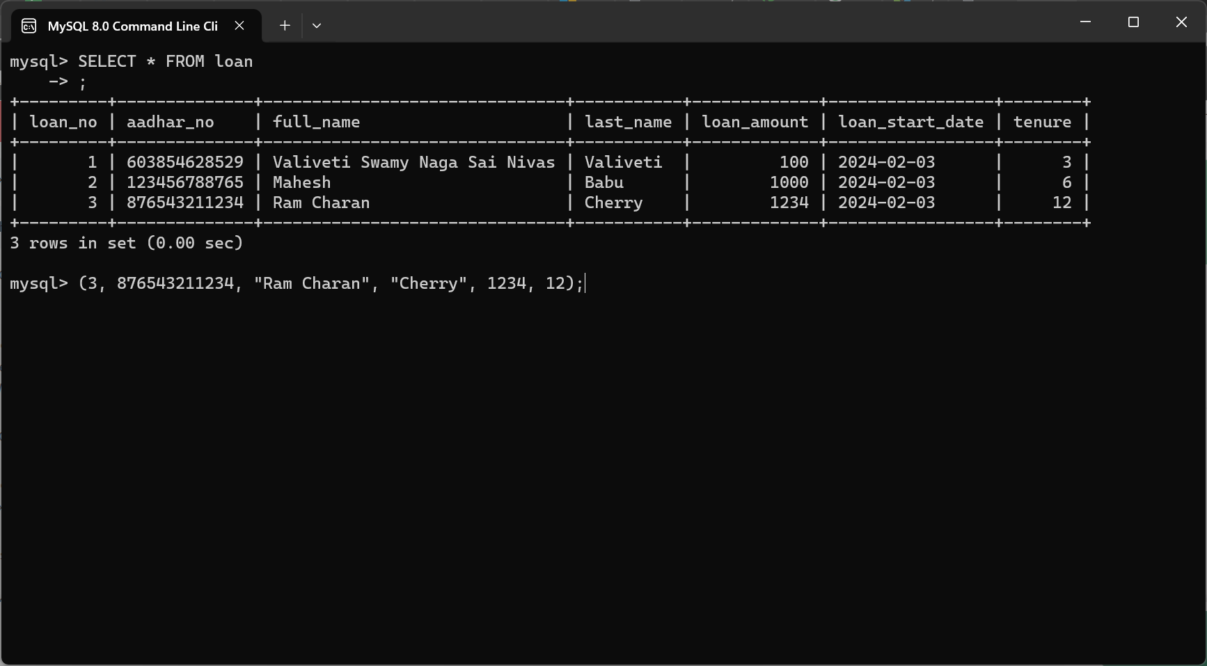
Initial records in the table

Slide 5
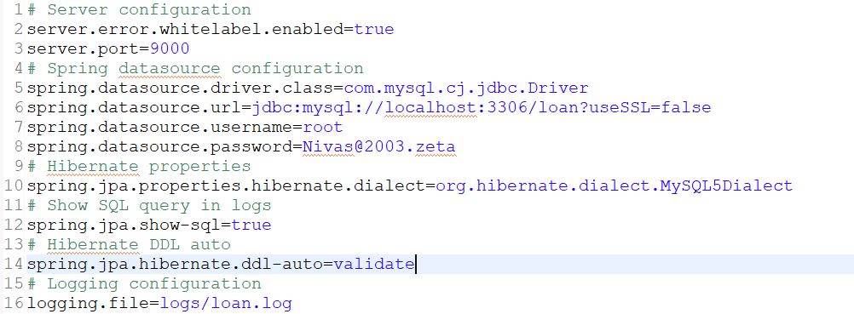
application.properties

Slide 6
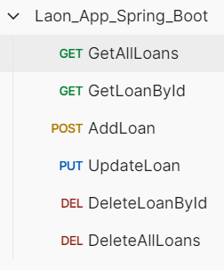





Adding All the Requests to PostMan

Slide 7
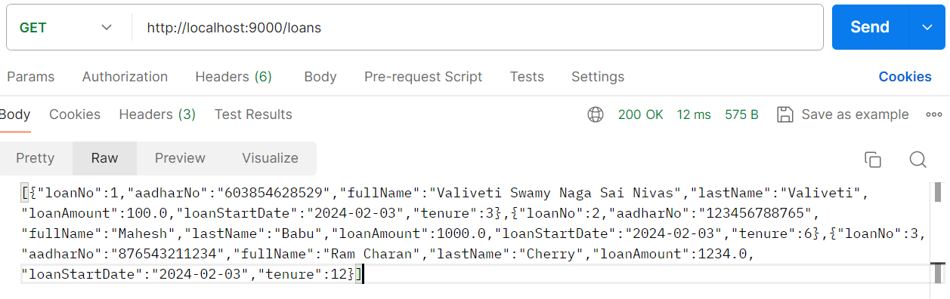
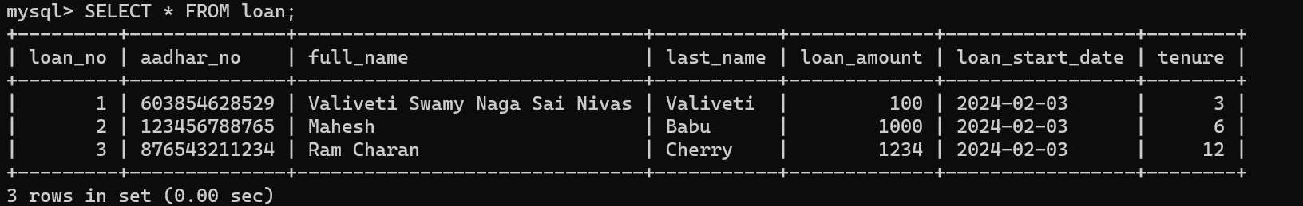
Getting all loans

Slide 8
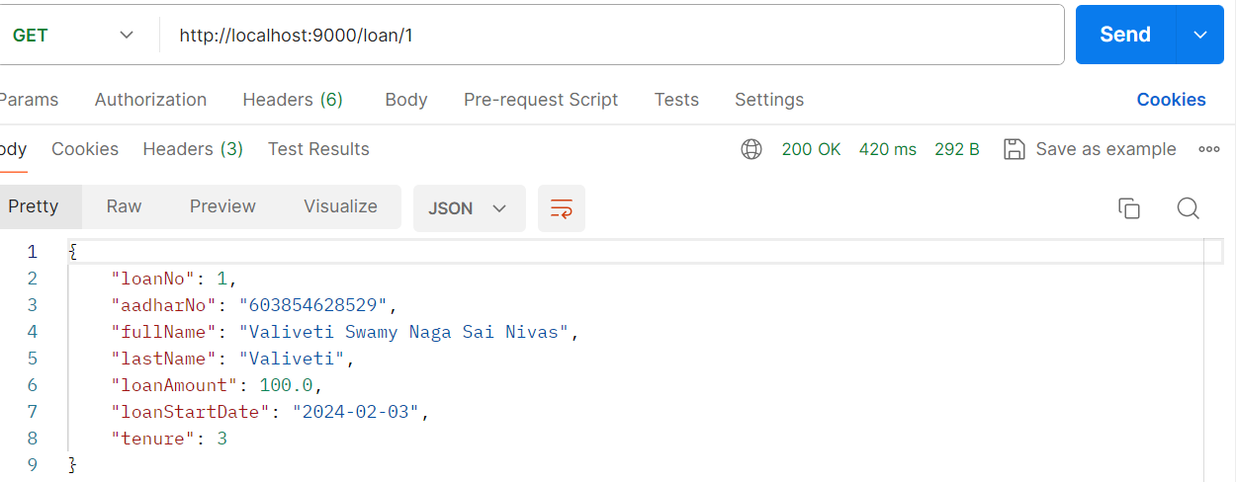
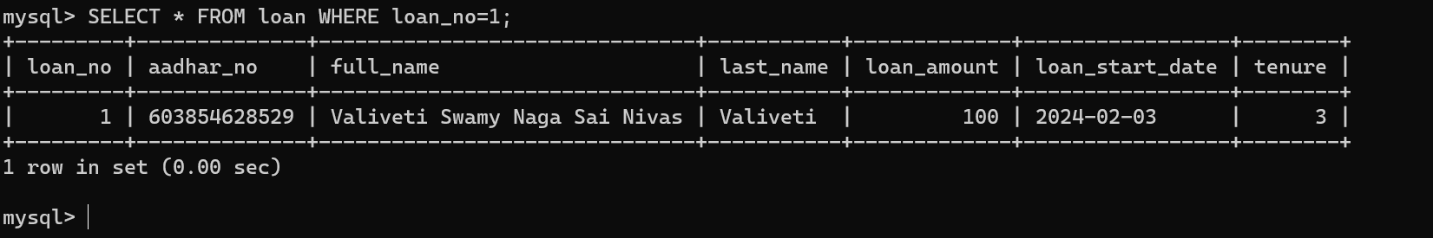
Getting loan by id

Slide 9
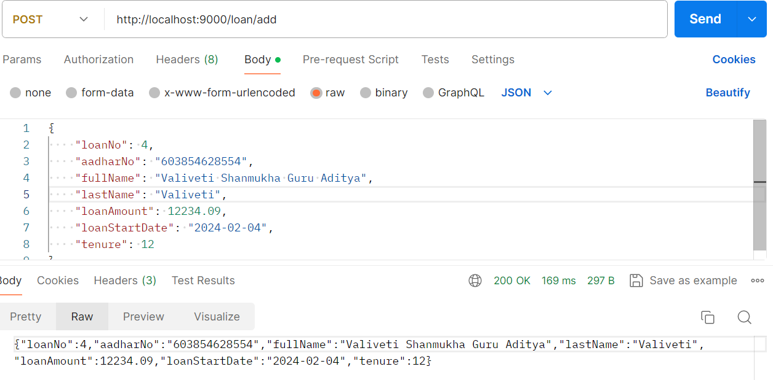
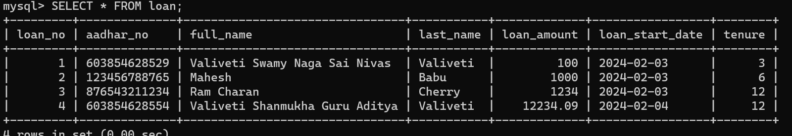
Adding new loan

Slide 10
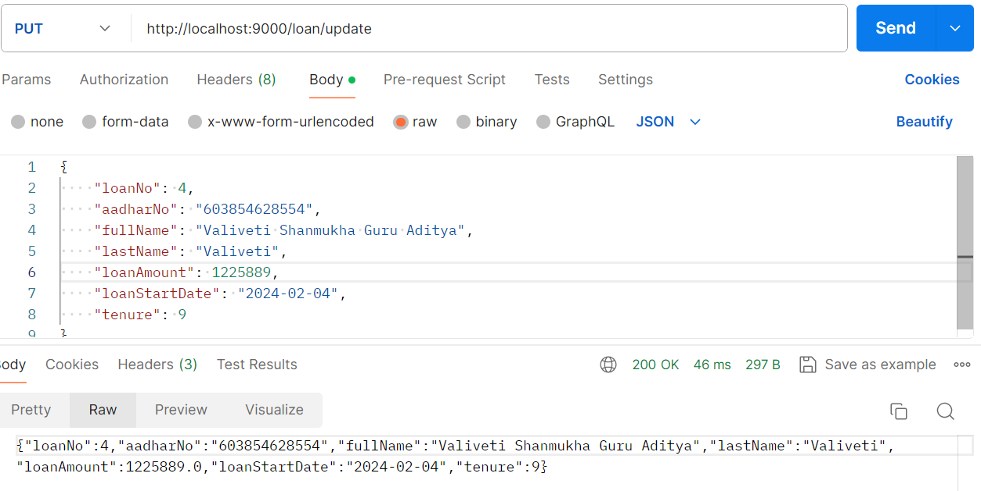
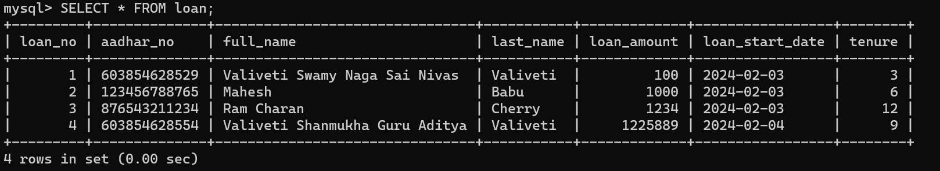
Updating the loan

Slide 11
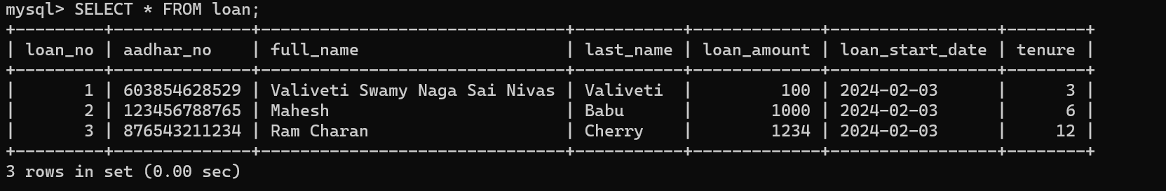
Deleting the loan by id

Slide 12
Deleting all the loans

Slide 13
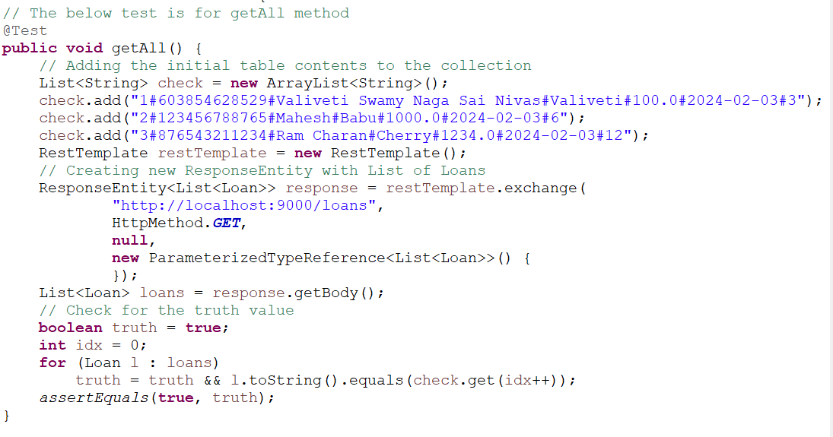
JUNIT Test Case for Getting all Loans

Slide 14
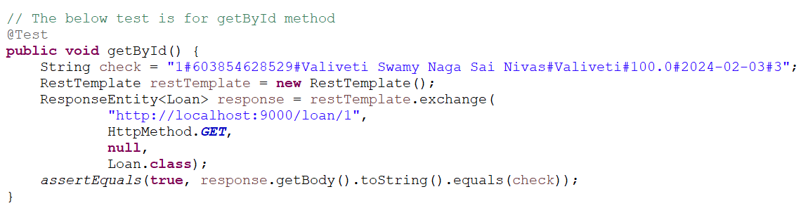
JUNIT Test Case for Getting One Loan

Slide 15
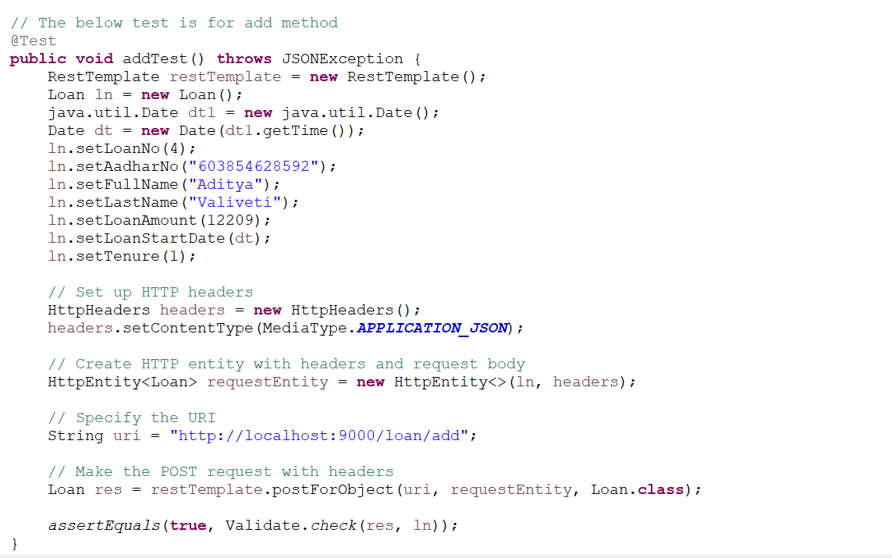
JUNIT Test Case for Adding Loan

Slide 16
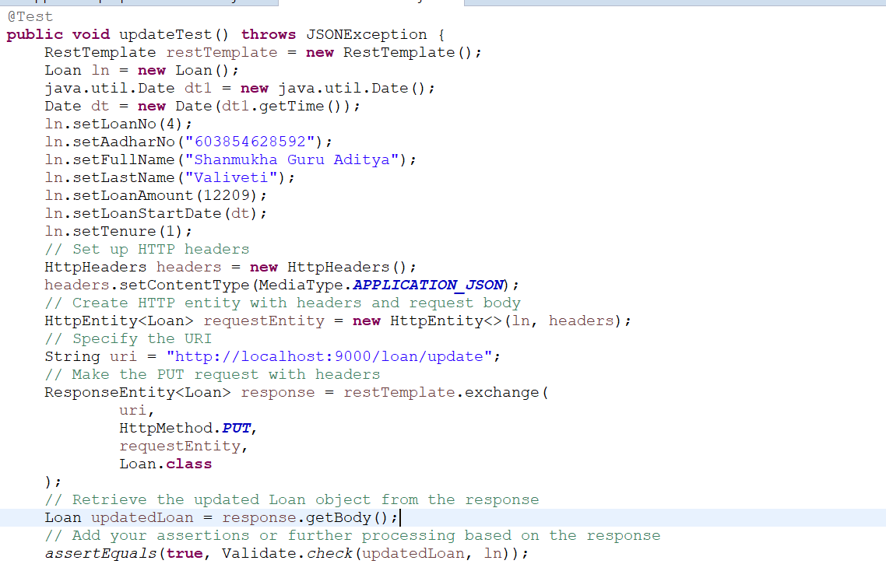
JUNIT Test Case for Updating Loan

Slide 17
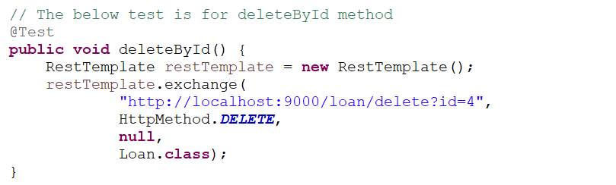
JUNIT Test Case for Deleting Loan

Slide 18
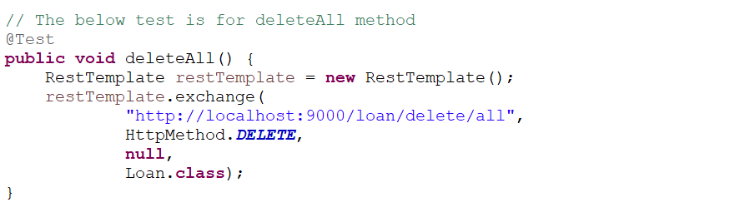
JUNIT Test Case for Deleting Loans

Slide 19
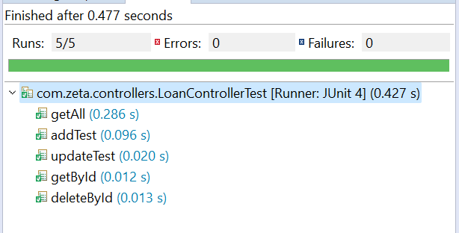
Running the JUnit Test Cases

Slide 20
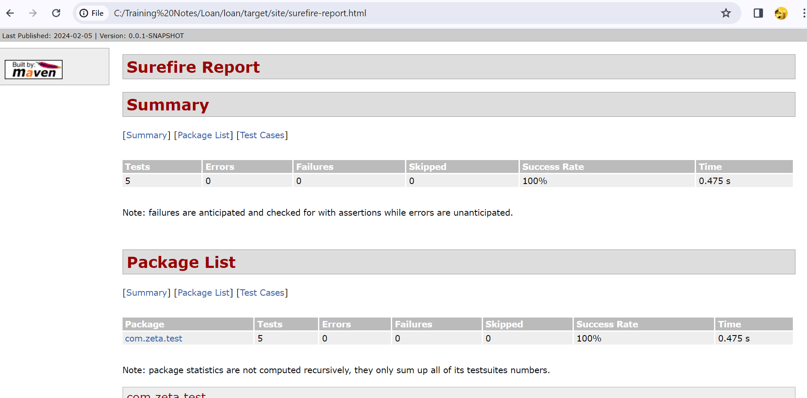
Surefire report

Slide 21
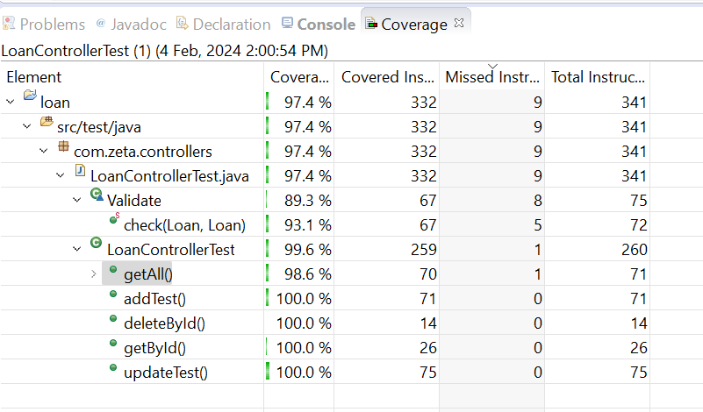
Code Coverage

Slide 22
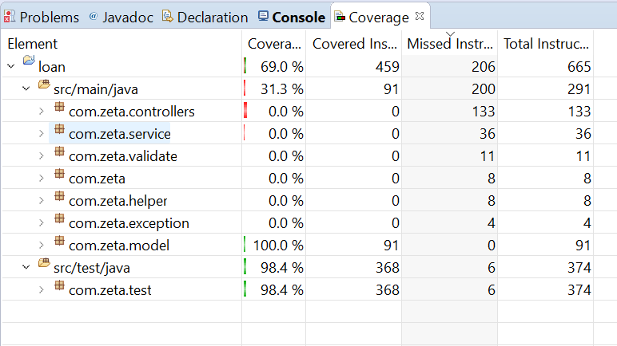
Code Coverage

Slide 23
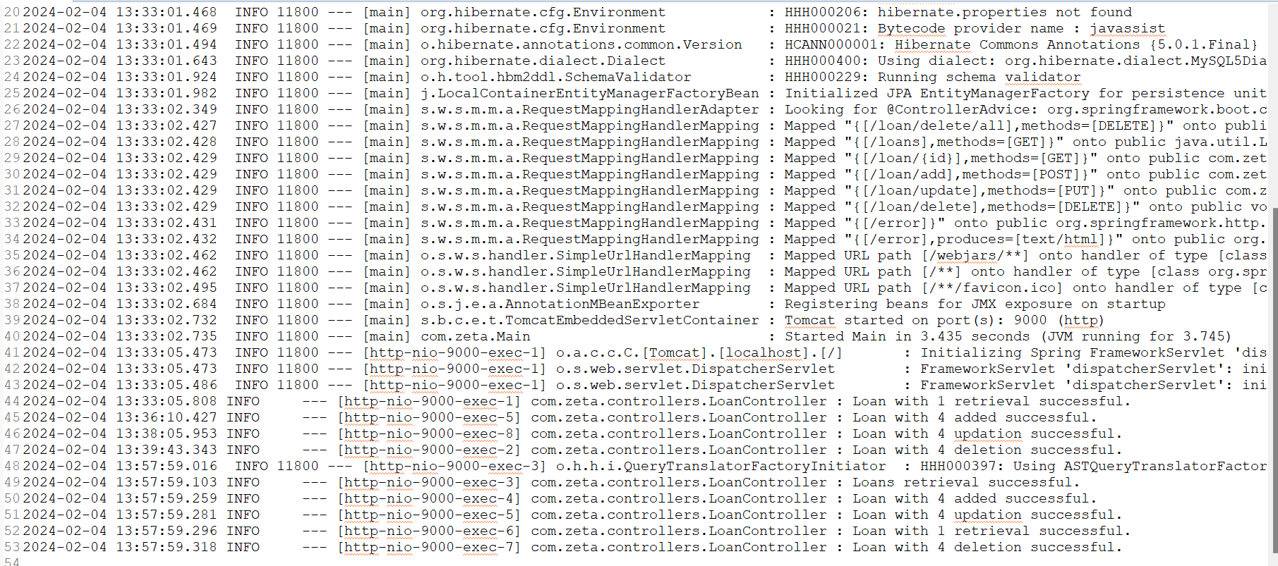
Log file

Slide 24
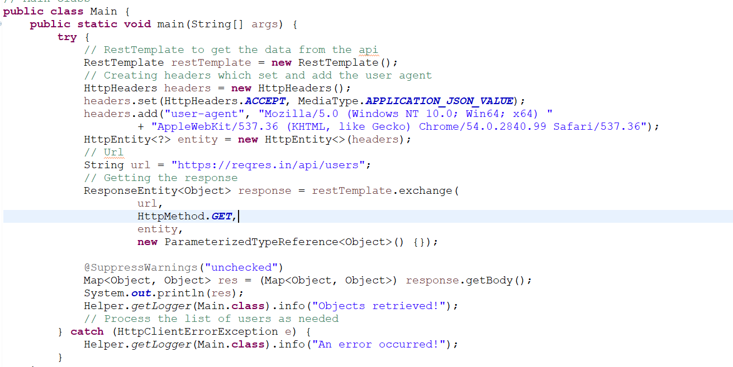
Task - 2

Slide 25
Output

Slide 26
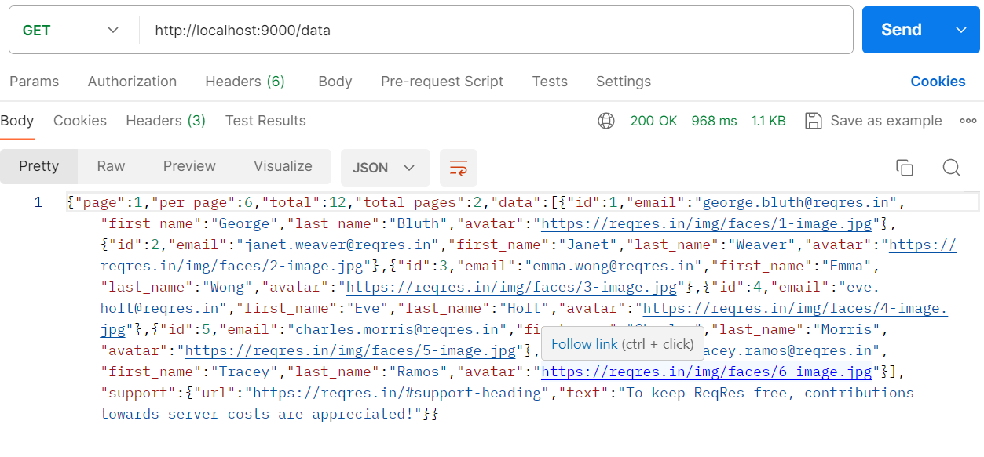
Postman

Slide 27
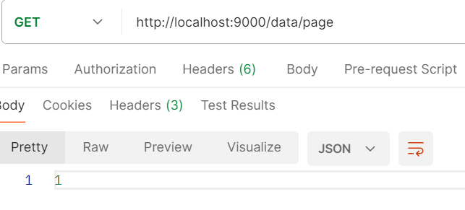
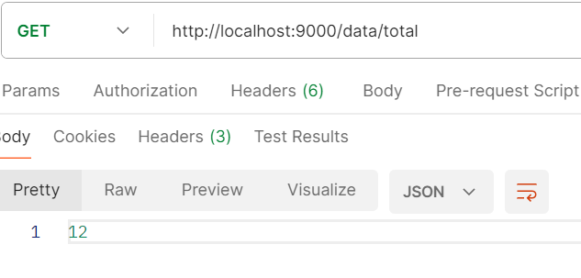
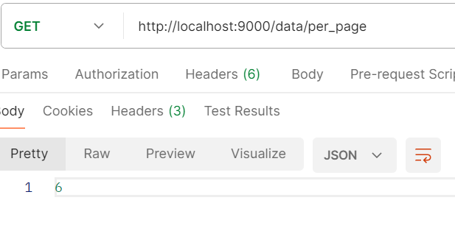
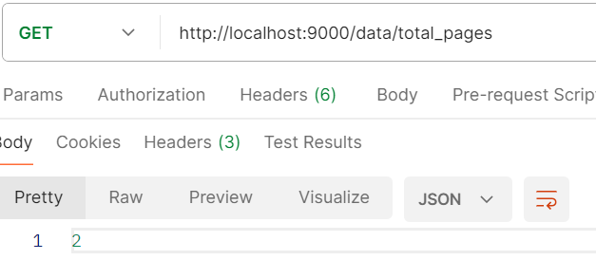

Slide 28
